Slide 1
Parallelization of Boids Algorithm
And speed up wrt sequential version
Relatore/i Bertini Marco

Slide 2
Titolo presentazione
arial bold 8 pt
Luogo e data arial regular 8 pt
Introduction
Project Goals
Implementation of Artificial life program «Boids» by Craig Reynolds
Program Parallelization by OpenMP library directives
Confront and speed up analysis wrt sequential program
Graphic visualization by SFML visual library

Slide 3
Titolo presentazione
arial bold 8 pt
Luogo e data arial regular 8 pt
Boids Algorithm
What are they?
Boids is an artificial life program, developed by Craig Reynolds in 1986, which simulates the flocking behavior of birds, and related group motion. The name "boid" corresponds to a shortened version of "bird-oid object", which refers to a bird-like object.
The main rules applied to boids are:
Separation: steer to avoid crowding local flock mates
Alignment: steer towards the average heading of local flock mates
Cohesion: steer to move towards the average position (center of mass) of local flock mates
Every object has a vertical and horizontal velocity as well as a vertical and horizontal position that they are updates according to the rules before.

Slide 4
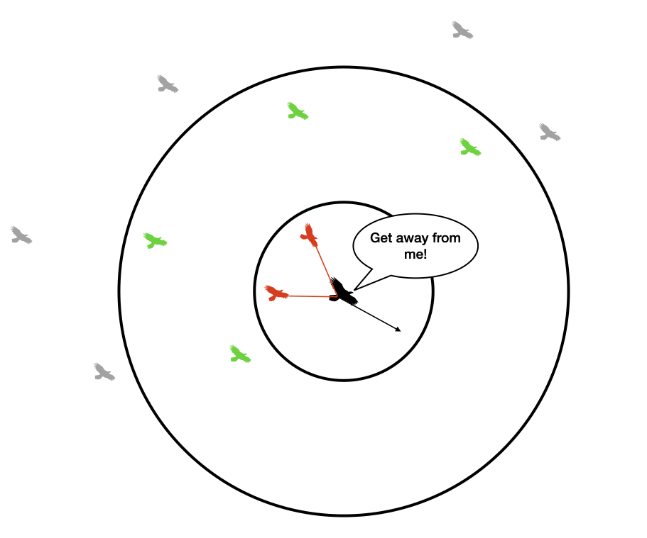
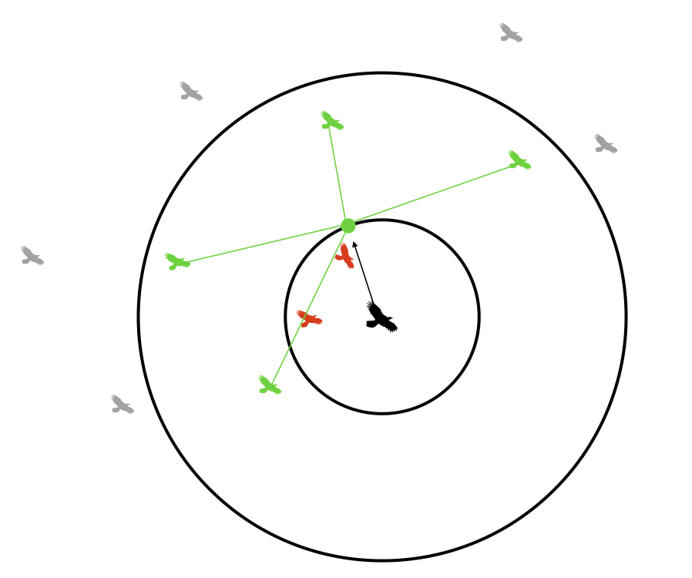
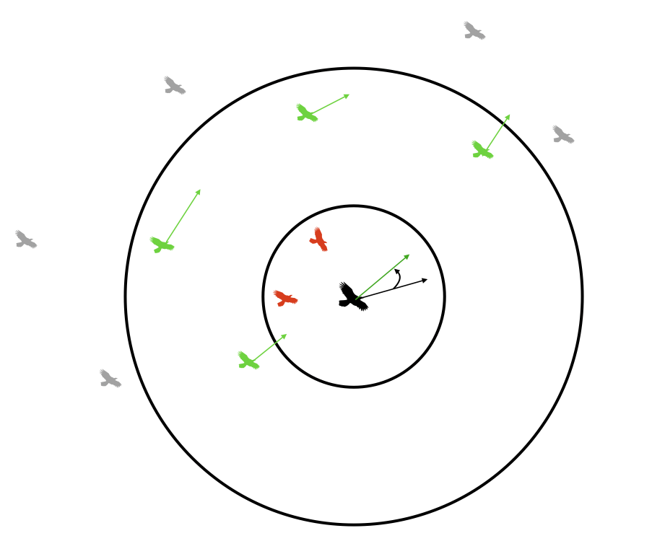
Started from left to right: Separation, cohesion and alignment rules

Slide 5
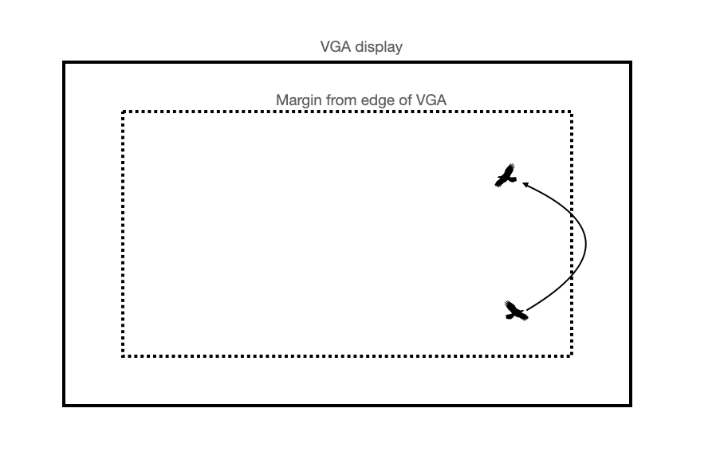
Screen Margin
Limit the range of boids movements
Another rules applied is the possible borders that the boids will tend to respect when moving.
The implementation is applied by setting up a display size and a margin height and width that, when a boid cross that, the velocity and position will be modified for go back inside

Slide 6
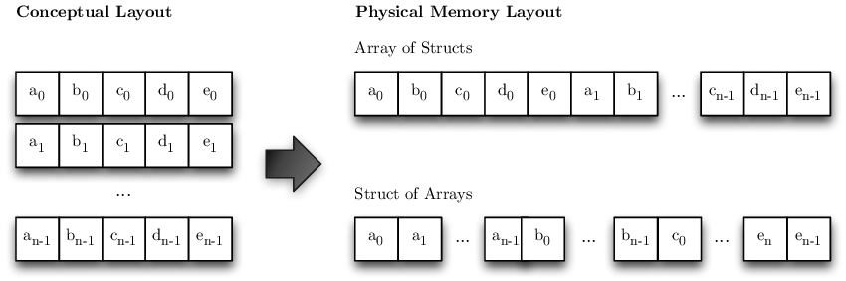
AoS vs SoA
The main objective of this project work was to confront the two main memory structure mostly used:
Array of Structure and Structure of Array.
In the first case every element in the array ( the array of all boids ) is a full object containing all its fields.
In the other case the structure contains several array of fields. This is optimal when running the same operation on one specific field.

Slide 7
Titolo presentazione
arial bold 8 pt
Luogo e data arial regular 8 pt
Experimental factors and result
Before started the measurement, several boids characteristic were fixed set. These are:
Turn factor
Visual Range
Protected Range
Avoids Factor
Centering Factor
Matching Factor
Furthermore, every boids has a minimum and max speed that it could have during the entire run.
We started the analysis with a small number of boids (1000 elements) with the same number of steps, and we gradually incremented the first one to see how the different data structures perform.
Elements Number | Time of AoS | Time of SoA
1000 | 0.605 s | 0.444 s
5000 | 10.702 s | 8.919 s
7000 | 23.59 s | 19.30 s
10000 | 44.385 s | 40.45 s

Slide 8
Titolo presentazione
arial bold 8 pt
Luogo e data arial regular 8 pt
Project Result
the structure of array’s type performs better than the other one. Those results happen because in SoA mode every boids detail is stored in a dedicated vector, so when dealing with calculate the distance for two flocks is faster then access with respect to access the single instance. If we needed to compute all the coordinates and the velocities instead, AoS should perform better
Elements Number | Sequential AoS | Sequential SoA | Speed Up
1000 | 1.621 s | 1.608 s | 1.632 / 1.618
5000 | 41.467 s | 41.405 s | 3.878/4.557
7000 | 80.285 s | 80.201 s | 3.790/11.095
10000 | 163.074 | 162.563 s | 4.044/4.544

